Slide 1


House Market Place
Guided By: Dr. Kanchan lata kashyap
Presented By:
Akanksha Shrivastava (22MCA10137)
Vaishnavi Nagvanshi (22MCA10189)
Suman Malakar (22MCA10142)
Glady s Thomas (22MCA10102)
Pawan Kayande(22MCA10158)

Slide 2
Introduction
An House market website is one that allows people to see and Buy Houses over the internet rather than at a brick-and-mortar location.
Front end of this project is made in React.
Back end of this product is maintained using Firebase.

Slide 3
Proposed work and methodology
PROBLEM STATEMENT
In this rapidly changing world, people busy with their daily life and work
Especially in big metropolitan cities, purchasing trusted houses is difficult for them
Because shops are very far and do not have enough time
Prices are high in the local market

Slide 4
Proposed work AND METHODOLOGY
SOLUTION
Prices are comparably low
Easy to purchase by a mobile device in some clicks
Easy to return in the certain time period

Slide 5
System requirement
Hardware Requirement
Processor: Intel Core i5
RAM: 8GB
HDD: 500GB
Software Requirement
Programming Language: React, NextJS
IDE: Visual Studio Code
SERVER-SITE TECHNOLOGY: NodeJS, NextJS, Mongo DB

Slide 6
Snapshots

Slide 7
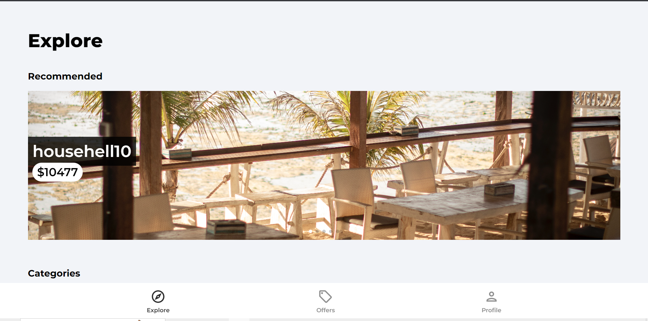

Slide 8
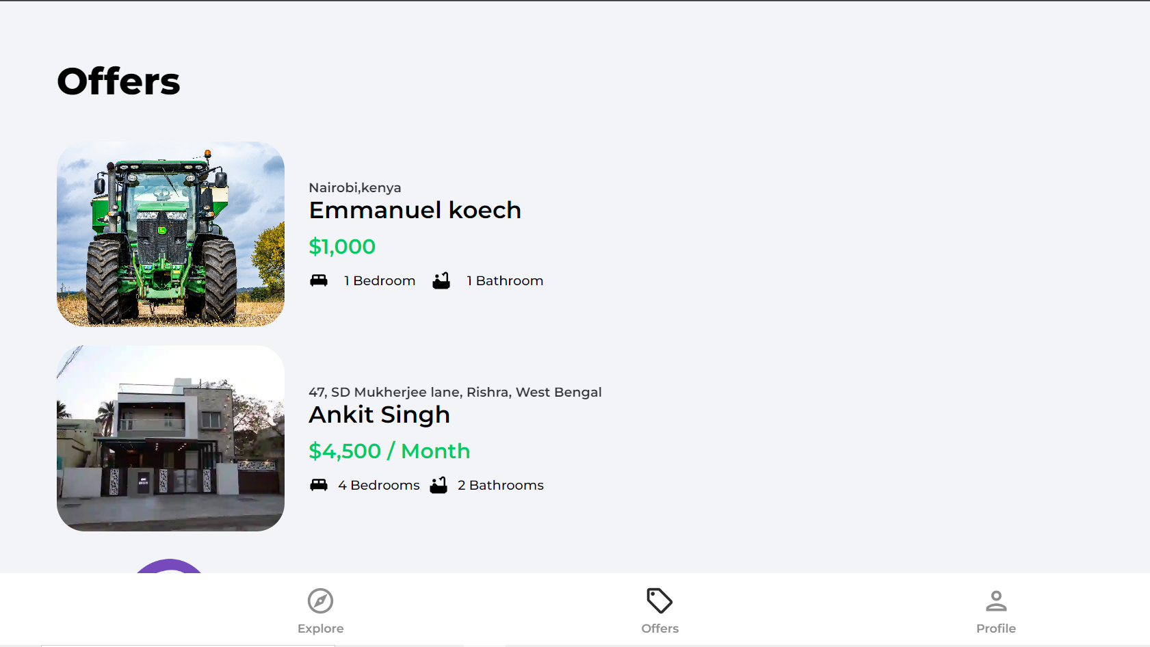

Slide 9
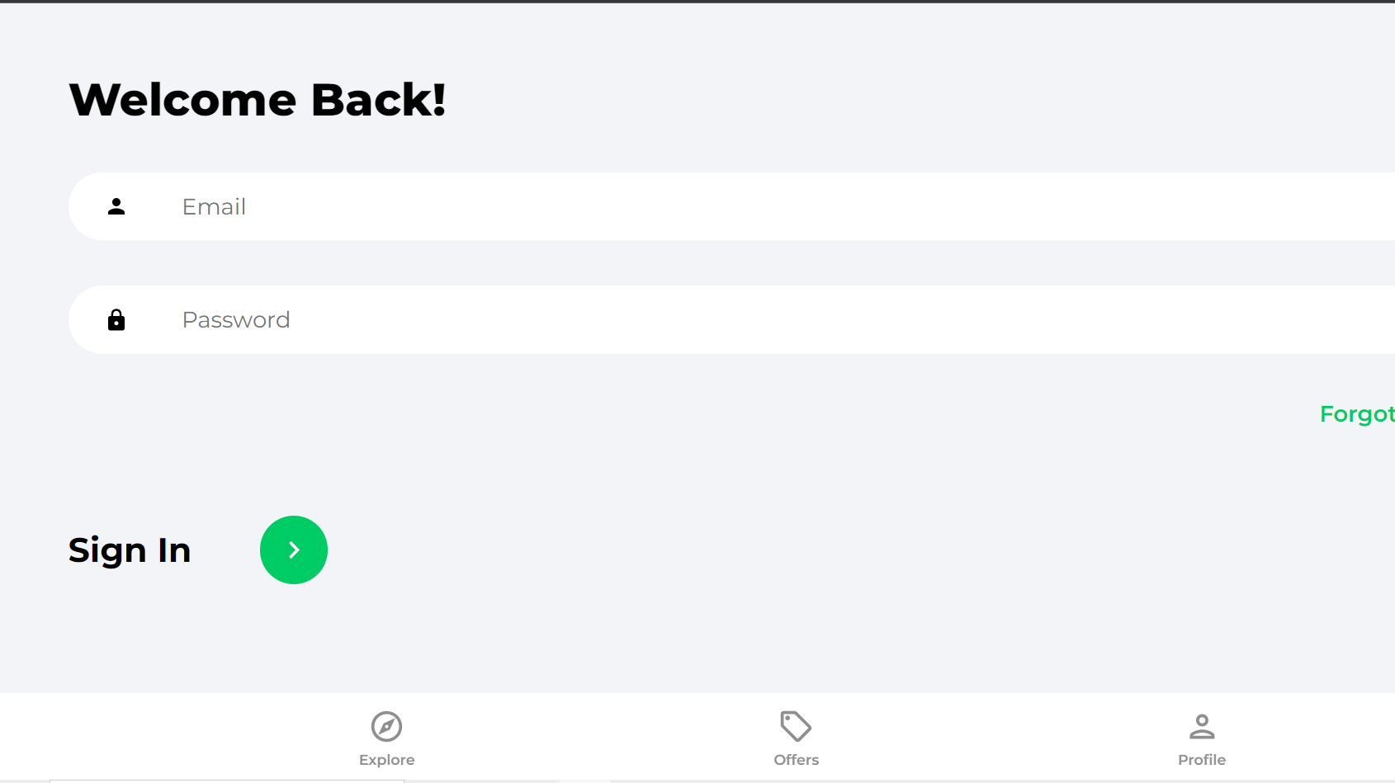

Slide 10
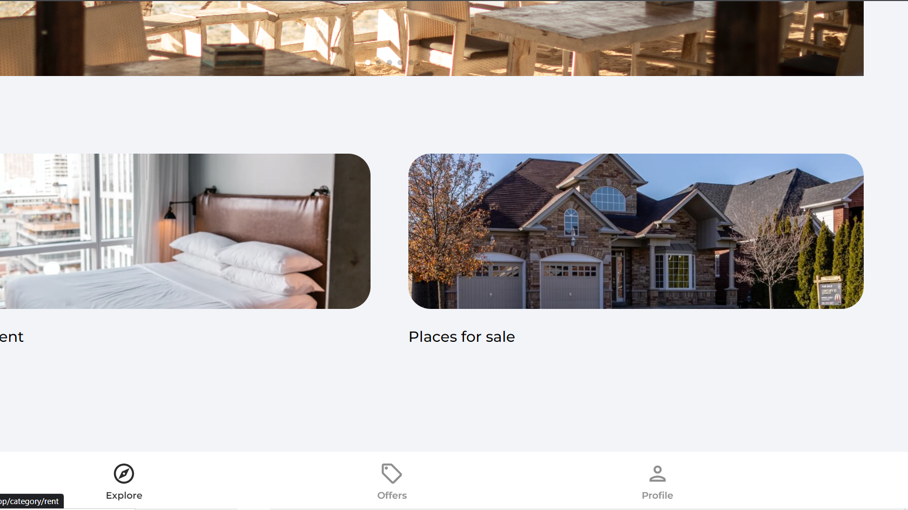

Slide 11
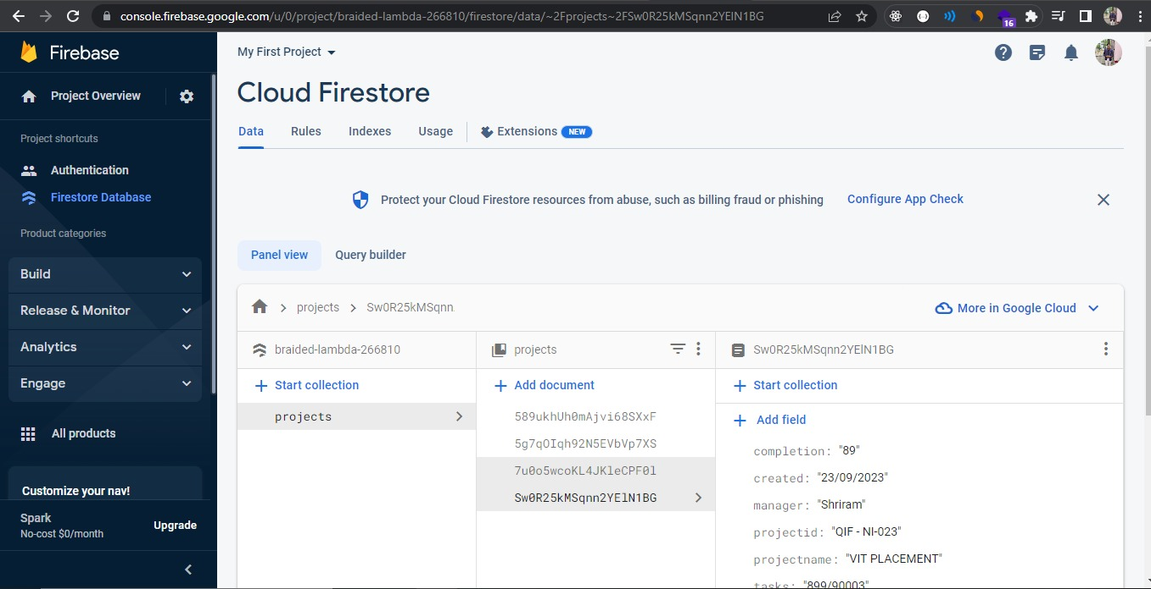

Slide 12
Thank you

